Slide 1
Decision Support and Business Intelligence Systems (9th Ed., Prentice Hall)
Chapter 1:
Decision Support Systems and Business Intelligence

Slide 2
Course Resources
Textbook :
Efraim Turban, Ramesh Sharda, Dursun Delen. Decision Support and Business Intelligence Systems, Prentice Hall Press, Upper Saddle River,NJ,2010
Additional Materials:
Lecture Slides.

Slide 3
Learning Objectives
Understand today's turbulent business environment and describe how organizations survive and even excel in such an environment (solving problems and exploiting opportunities)
Understand the need for computerized support of managerial decision making
Understand an early framework for managerial decision making
Learn the conceptual foundations of the decision support systems (DSS)

Slide 4
Learning Objectives – cont.
Describe the business intelligence (BI) methodology and concepts and relate them to DSS
Describe the concept of work systems and its relationship to decision support
List the major tools of computerized decision support
Understand the major issues in implementing computerized support systems

Slide 5
Opening Vignette:
“Norfolk Southern Uses BI for Decision Support to Reach Success”
Company background
Problem
Proposed solution
Results
Answer and discuss the case questions

Slide 6
Changing Business Environment
Companies are moving aggressively to computerized support of their operations => Business Intelligence
Business Pressures–Responses–Support Model, there are 3 components:
Business pressures result of today's competitive business climate
Responses (actions taken) to counter the pressures
Support to better facilitate the process and enhance response actions

Slide 7
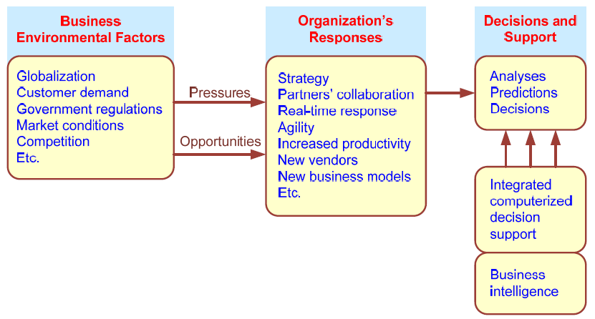
Business Pressures–Responses–Support Model

Slide 8
The Business Environment
The environment in which organizations operate today is becoming more and more complex, creating:
opportunities, and
problems
Example: globalization
Business environment factors can be divided into 4 major categories:
markets, consumer demands, technology, and societal…

Slide 9
Business Environment Factors that creates pressures on organizations
FACTOR DESCRIPTION
Markets Strong competition
Expanding global markets
Blooming electronic markets on the Internet
Innovative marketing methods
Opportunities for outsourcing with IT support
Need for real-time, on-demand transactions
Consumer Desire for customization
demand Desire for quality, diversity of products, and speed of delivery
Customers getting powerful and less loyal
Technology More innovations, new products, and new services
Increasing obsolescence rate
Increasing information overload
Social networking, Web 2.0 and beyond
Societal Growing government regulations and deregulation
Workforce more diversified, older, and composed of more women Prime concerns of homeland security and terrorist attacks
Necessity of Sarbanes-Oxley Act and other reporting-related legislation Increasing social responsibility of companies
Greater emphasis on sustainability

Slide 10
Organizational Responses
Be Reactive, Anticipative, Adaptive, and Proactive
Managers may take actions, such as
Employ strategic planning
Use new and innovative business models
Restructure business processes
Participate in business alliances
Improve corporate information systems
Improve partnership relationships
Encourage innovation and creativity …cont…>

Slide 11
Managers actions, continued
Improve customer service and relationships
Move to electronic commerce (e-commerce)
Move to make-to-order production and on-demand manufacturing and services
Use new IT to improve communication, data access (discovery of information), and collaboration
Respond quickly to competitors' actions (e.g., in pricing, promotions, new products and services)
Automate many tasks of white-collar employees
Automate certain decision processes
Improve decision making by employing analytics

Slide 12
Closing the Strategy Gap
One of the major objectives of computerized decision support is
To facilitate closing the gap between the current performance of an organization and its desired performance, as expressed in its mission, objectives, and goals, and the strategy to achieve them

Slide 13
Review Questions
List the components of and explain the Business Pressures-Responses--Support model.
What are some of the major factors in today’s business environment?
what are some of the major response activities that Organizations take?

Slide 14
Managerial Decision Making
Management is a process by which organizational goals are achieved by using resources
Inputs: resources
Output: attainment of goals
Measure of success: outputs / inputs

Slide 15
Managerial Decision Making
The level of productivity or the success of management depends on the performance of managerial functions such as planning, organizing, directing, and controlling.
To perform their functions, managers are engaged in a continuous process of making decisions.
Management ≅ Decision Making
Decision making: selecting the best solution from two or more alternatives

Slide 16
Mintzberg's 10 Managerial Roles
Interpersonal
1. Figurehead
2. Leader
3. Liaison
Informational
4. Monitor
5. Disseminator
6. Spokesperson
Decisional
7. Entrepreneur
8. Disturbance handler
9. Resource allocator
10. Negotiator

Slide 17
Decision Making Process
Managers usually make decisions by following a four-step process (a.k.a. the scientific approach)
Define the problem (or opportunity)
Construct a model that describes the real-world problem
Identify possible solutions to the modeled problem and evaluate the solutions
Compare, choose, and recommend a potential solution to the problem

Slide 18
Decision making is difficult, because
Technology, information systems, advanced search engines, and globalization result in more and more alternatives from which to choose
Government regulations and the need for compliance, political instability and terrorism, competition, and changing consumer demands produce more uncertainty, making it more difficult to predict consequences and the future
Other factors are the need to make rapid decisions, the frequent and unpredictable changes that make trial-and-error learning difficult, and the potential costs of making mistakes

Slide 19
Review Questions
Describe the three major managerial roles and list some of the specific activities in each.
Why have some argued that management is the same as decision making?
Describe the four steps managers take in making a decision.

Slide 20
Why Use Computerized DSS
Computerized DSS can facilitate decision via:
Speedy computations
Improved communication and collaboration
Increased productivity of group members
Improved data management
Overcoming cognitive limits
Quality support; agility support
Using Web; anywhere, anytime support

Slide 21
Review Questions
How have the capabilities of computing evolved over time?
List some capabilities of computing that can facilitate managerial decision making.
How can a computer help overcome the cognitive limits of humans?
Why is the Web considered so important for decision support?

Slide 22
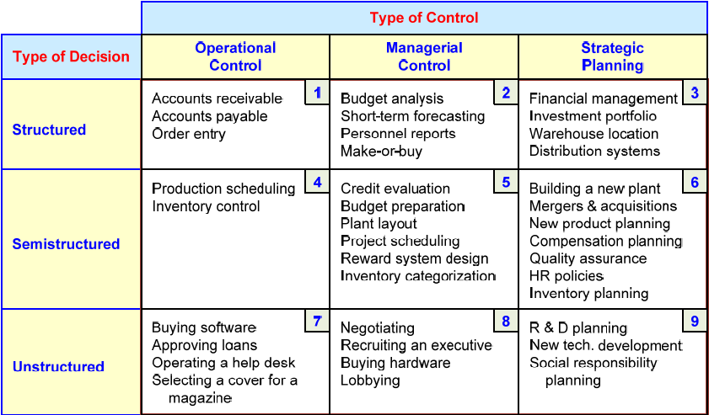
A Decision Support Framework (by Gory and Scott-Morten, 1971)

Slide 23
A Decision Support Framework – cont.
Degree of Structuredness (Simon, 1977)
Decision are classified as
Highly structured (i.e. programmed)
Semi-structured
Highly unstructured (i.e., non-programmed)
Types of Control (Anthony, 1965)
Strategic planning (top-level, long-range)
Management control (tactical planning, efficient use of resources)
Operational control (execution of specific tasks)

Slide 24
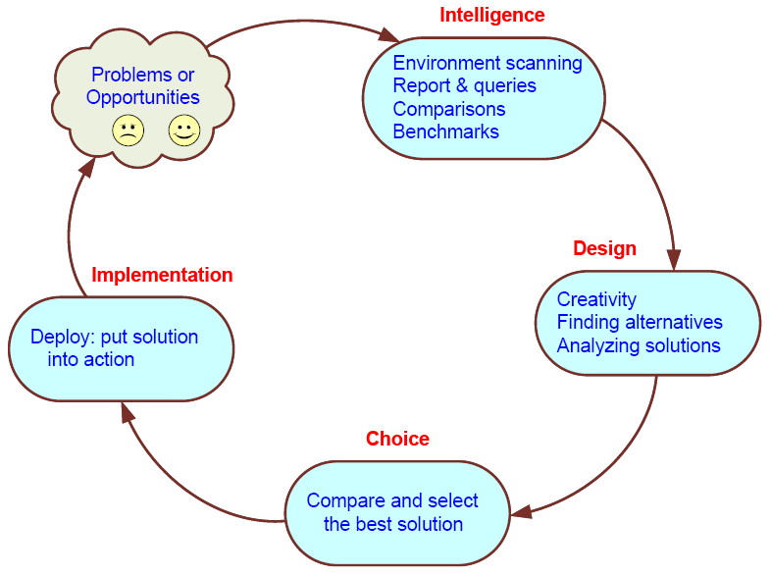
Simon’s Decision-Making Process

Slide 25
Computer Support for Structured Decisions
Structured problems: encountered repeatedly, have a high level of structure
It is possible to abstract, analyze, and classify them into specific categories
e.g., make-or-buy decisions, capital budgeting, resource allocation, distribution, procurement, and inventory control
For each category a solution approach is developed => Management Science

Slide 26
Management Science Approach
Also referred to as Operation Research
In solving problems, managers should follow the five-step MS approach
Define the problem
Classify the problem into a standard category (*)
Construct a model that describes the real-world problem
Identify possible solutions to the modeled problem and evaluate the solutions
Compare, choose, and recommend a potential solution to the problem

Slide 27
Automated Decision Making
A relatively new approach to supporting decision making
Applies to highly structures decisions
Automated decision systems (ADS)
(or decision automation systems)
An ADS is a rule-based system that provides a solution to a repetitive managerial problem in a specific area
e.g., simple-loan approval system

Slide 28
Automated Decision Making
ADS initially appeared in the airline industry called revenue (or yield) management (or revenue optimization) systems
dynamically price tickets based on actual demand
Today, many service industries use similar pricing models
ADS are driven by business rules!

Slide 29
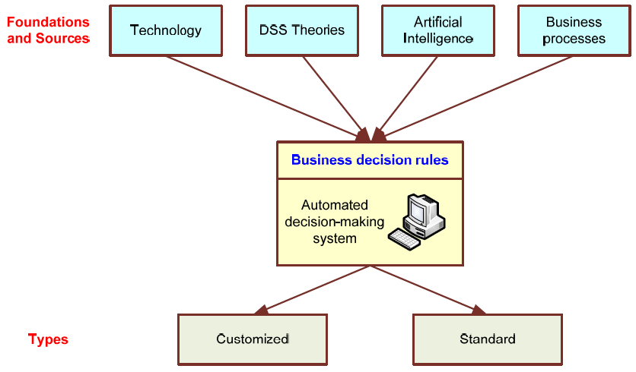
Automated Decision-Making Framework

Slide 30
Computer Support for Unstructured Decisions
Unstructured problems can be only partially supported by standard computerized quantitative methods
They often require customized solutions
They benefit from data and information
Intuition and judgment may play a role
Computerized communication and collaboration technologies along with knowledge management is often used

Slide 31
Computer Support for Semi-structured Problems
Solving semi-structured problems may involve a combination of standard solution procedures and human judgment
MS handles the structured parts while DSS deals with the unstructured parts
With proper data and information, a range of alternative solutions, along with their potential impacts

Slide 32
Review Questions
What are structured. unstructured. and semistructured decisions? Provide two examples of each.
Define operational control, managerial control, and strategic planning. Provide two
What are the nine cells of the decision framework? Explain what each is for.
How can computers provide support for making structured decisions?
Define automated decision systems (ADS).
How can computers provide support to semistructured decisions.

Slide 33
Concept of Decision Support Systems
Classical Definitions of DSS
Interactive computer-based systems, which help decision makers utilize data and models to solve unstructured problems" - Gorry and Scott-Morton, 1971
Decision support systems couple the intellectual resources of individuals with the capabilities of the computer to improve the quality of decisions. It is a computer-based support system for management decision makers who deal with semistructured problems - Keen and Scott-Morton, 1978

Slide 34
DSS as an Umbrella Term
The term DSS can be used as an umbrella term to describe any computerized system that supports decision making in an organization
E.g., an organization wide knowledge management system; a decision support system specific to an organizational function (marketing, finance, accounting, manufacturing, planning, SCM, Expert systems, etc.)

Slide 35
DSS as a Specific Application
In a narrow scope DSS refers to a process for building customized applications for unstructured or semi-structured problems
Components of the DSS Architecture
Data, Model, Knowledge/Intelligence, User, Interface (API and/or user interface)
DSS often is created by putting together loosely coupled instances of these components
In many DSS, the components are standards and can be purchased.
But in other situations, especially unstructured ones, it is necessary to custom build some or all of the components

Slide 36
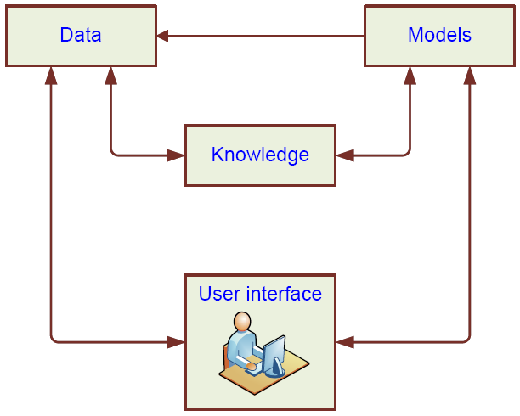
High-Level Architecture of a DSS
User

Slide 37
Types of DSS
Two major types:
Model-oriented DSS
Data-oriented DSS
Evolution of DSS into Business Intelligence
Use of DSS moved from specialist to managers, and then whomever, whenever, wherever
Enabling tools like OLAP, data warehousing, data mining, intelligent systems, delivered via Web technology have collectively led to the term “business intelligence” (BI) and “business analytics”

Slide 38
Review Questions
Provide two definitions of DSS.
Describe DSS as an umbrella term.
Describe the architecture of DSS.

Slide 39
Business Intelligence (BI)
BI is an umbrella term that combines architectures, tools, databases, analytical tools, applications, and methodologies
Like DSS, BI a content-free expression, so it means different things to different people
BI's major objective is to enable easy access , and manipulate to data (and models) to provide business managers with the ability to conduct analysis
BI helps transform data, to information (and knowledge), to decisions and finally to action

Slide 40
A Brief History of BI
The term BI was coined by the Gartner Group in the mid-1990s
However, the concept is much older
1970s - MIS reporting - static/periodic reports
1980s - Executive Information Systems (EIS)
1990s - OLAP, dynamic, multidimensional, ad-hoc reporting -> coining of the term “BI”
2005+ Inclusion of AI and Data/Text Mining capabilities; Web-based Portals/Dashboards
2010s - yet to be seen

Slide 41
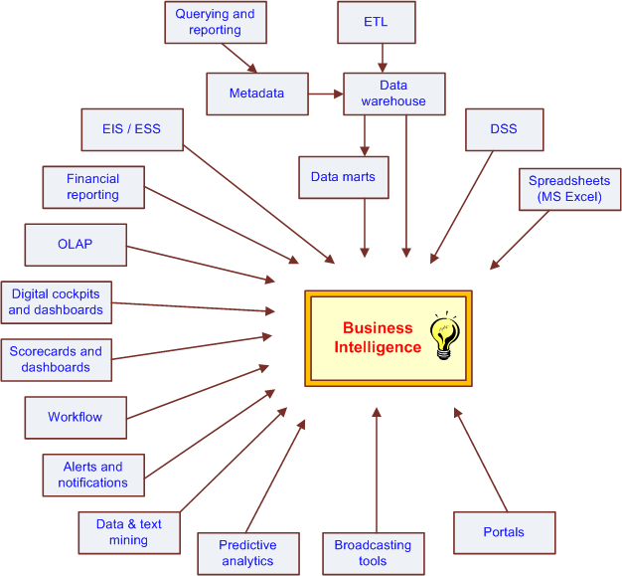
The Evolution of BI Capabilities

Slide 42
The Architecture of BI
A BI system has four major components
a data warehouse, with its source data
business analytics, a collection of tools for manipulating, mining, and analyzing the data in the data warehouse;
business performance management (BPM) for monitoring and analyzing performance
a user interface (e.g., dashboard)

Slide 43
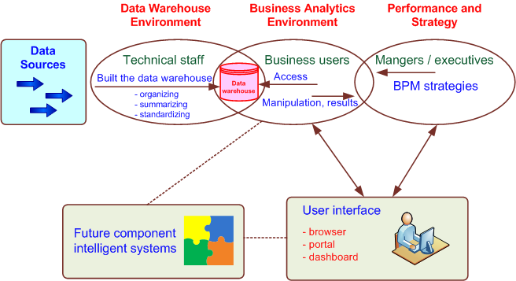
A High-Level Architecture of BI

Slide 44
Components in a BI Architecture
The data warehouse is a large repository of well-organized historical data
Business analytics are the tools that allow transformation of data into information and knowledge
Business performance management (BPM) allows monitoring, measuring, and comparing key performance indicators
User interface (e.g., dashboards) allows access and easy manipulation of other BI components

Slide 45
Styles of BI
MicroStrategy Corp. distinguishes five styles of BI and offers tools for each
report delivery and alerting
enterprise reporting (using dashboards and scorecards)
cube analysis (also known as slice-and-dice analysis)
ad-hoc queries
statistics and data mining

Slide 46
The Benefits of BI
The ability to provide accurate information when needed, including a real-time view of the corporate performance and its parts
A survey by Thompson (2004)
Faster, more accurate reporting (81%)
Improved decision making (78%)
Improved customer service (56%)
Increased revenue (49%)
See Table 1.3 for a list of BI analytic applications, the business questions they answer and the business value they bring

Slide 47
The DSS–BI Connection
First, their architectures are very similar because BI evolved from DSS
BI implies the use of data warehouse
BI is more appropriate for large organizations, but DSS is appropriate to any type of organizations
Second, DSS directly support specific decision making, while BI provides accurate and timely information, and indirectly support decision making
Third, BI has an executive and strategy orientation, especially in its BPM and dashboard components, while DSS, in contrast, is oriented toward analysts

Slide 48
The DSS–BI Connection – cont.
Fourth, most BI systems are constructed with commercially available tools and components, while DSS is often built from scratch
Fifth, DSS methodologies and even some tools were developed mostly in the academic world, while BI methodologies and tools were developed mostly by software companies
Sixth, many of the tools that BI uses are also considered DSS tools (e.g., data mining and predictive analysis are core tools in both)

Slide 49
The DSS–BI Connection – cont.
Although some people equate DSS with BI, these systems are not, at present, the same
some people believe that DSS is a part of BI—one of its analytical tools
others think that BI is a special case of DSS that deals mostly with reporting, communication, and collaboration (a form of data-oriented DSS)
BI is a result of a continuous revolution and, as such, DSS is one of BI's original elements
In this book, we separate DSS from BI
MSS = BI and/or DSS

Slide 50
The DSS–BI Connection – cont.
MSS: Management Support system
Is a broad concept to be viewed as a technology that supports managerial tasks in general and decision making in particular

Slide 51
Review Questions
Define BI
List and describe the major components of BI.
List and describe the major tangible benefits and intangible benefits of BI.
What are the major similarities and differences of DSS and BI
Define MSS

Slide 52
A Work System View of Decision Support (Alter, 2004)
drop the word “systems” from DSS
focus on “decision support”
“use of any plausible computerized or noncomputerized means for improving decision making in a particular repetitive or nonrepetitive business situation in a particular organization”
Alter assumed that decision support may come from different aspects of work systems
Work system: a system in which human participants and/or machines perform a business process, using information, technology, and other resources, to produce products and/or services for internal or external customers

Slide 53
Elements of a Work System
Business process. Variations in the process rationale, sequence of steps, or methods used for performing particular steps
Participants. Better training, better skills, higher levels of commitment, or better real-time or delayed feedback
Information. Better information quality, information availability, or information presentation
Technology. Better data storage and retrieval, models, algorithms, statistical or graphical capabilities, or computer interaction
-->

Slide 54
Elements of a Work System – cont.
Product and services. Better ways to evaluate potential decisions
Customers. Better ways to involve customers in the decision process and to obtain greater clarity about their needs
Infrastructure. More effective use of shared infrastructure, which might lead to improvements
Environment. Better methods for incorporating concerns from the surrounding environment
Strategy. A fundamentally different operational strategy for the work system

Slide 55
Review Questions
What is Alter’s definition of decision support
Define work system
List the nine elements of a work system
Explain how decision making can be improved by changing an element of a work system

Slide 56
Major Tool Categories for MSS
Source: Table 1.4

Slide 57
Hybrid (Integrated) Support Systems
The objective of computerized decision support, regardless of its name or nature, is to assist management in solving managerial or organizational problems (and assess opportunities and strategies) faster and better than possible without computers
Every type of tool has certain capabilities and limitations. By integrating several tools, we can improve decision support because one tool can provide advantages where another is weak
The trend is therefore towards developing
hybrid (integrated) support system

Slide 58
Hybrid (Integrated) Support Systems
Type of integration
Use each tool independently to solve different aspects of the problem
Use several loosely integrated tools. This mainly involves transferring data from one tool to another for further processing
Use several tightly integrated tools. From the user's standpoint, the tool appears as a unified system
In addition to performing different tasks in the problem-solving process, tools can support each other

Slide 59
Review Questions
List the major categories of decision support system

Slide 60
End of the Chapter
Questions / Comments…

Slide 61
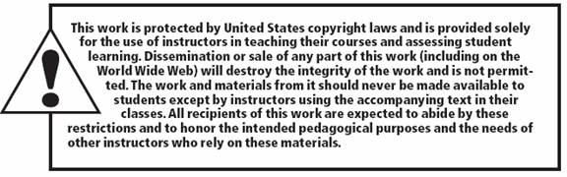
All rights reserved. No part of this publication may be reproduced, stored in a retrieval system, or transmitted, in any form or by any means, electronic, mechanical, photocopying, recording, or otherwise, without the prior written permission of the publisher. Printed in the United States of America.
Copyright © 2011 Pearson Education, Inc.
Publishing as Prentice Hall

